Slide 1
Constructive Computer Architecture
Thomas – EPFL
L01 – February 18, 2024
Slides adapted from 6.1920 with Arvind (Spring 23, MIT)

Slide 2
Pillars of real architecture
Firmitas (Durability)
Utilitas (Utility)
Venustas (Beauty)
What are the pillars of computer architecture?

Slide 3
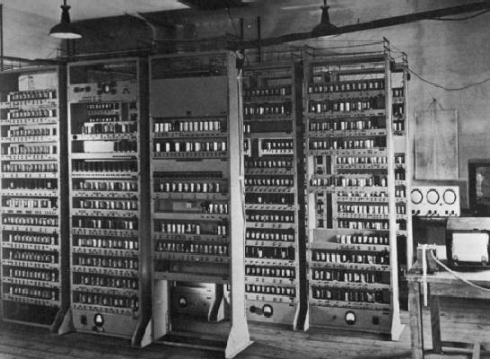
Computing Devices Then… EDSAC, University of Cambridge, UK, 1949
Notes:
Fishbowl computing. Dramatic changes since then.

Slide 4

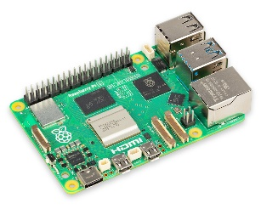

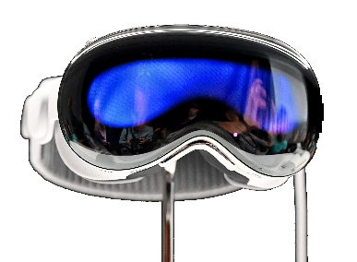
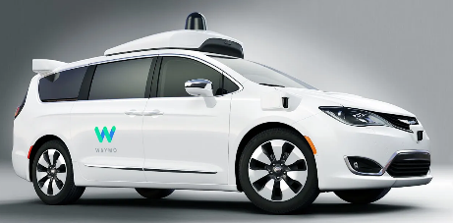
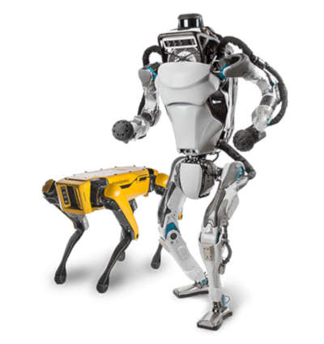
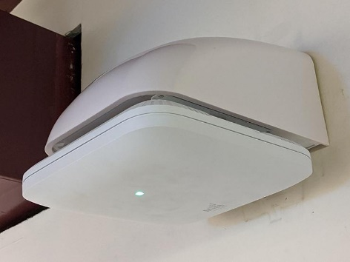
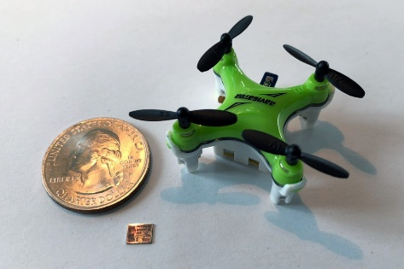
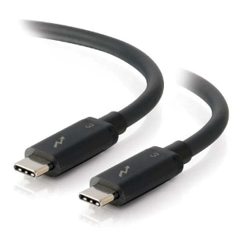
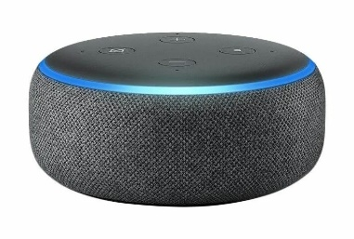



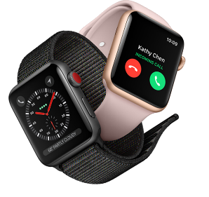
Computing Devices Now
Dramatic progress in terms of size, speed, cost, reliability

Slide 5
Computer architecture is about designing machines to meet some power, performance, cost and size constraints

Slide 6
Studying Computer Architecture
A method of constructing machines: Machine descriptions which can be simulated in software and synthesized into hardware
Quantitative evaluation: To what extent designs meet various design criteria
Testing and verification: Does the machine do what it is supposed to do

Slide 7
The goals of this subject
Study computer architecture by constructing many different machines
Learn a new method of describing architectures where there is less emphasis on diagrams and more emphasis on executable descriptions
Each architecture and each part of it would be defined as executable code in Bluespec System Verilog (BSV)
Learning about a model of parallel programming
Learn a bit about test benches
Learn about quantitative evaluation of designs

Slide 8
All the designs you do in this course can be implemented as ASICs/FPGAs without any changes in the source code. Though time will not permit the class to explore ASICs/FPGAs

Slide 9
Outline
First 3-4 weeks: basic of our programming paradigm
Core part of the class: from simple architectures to more advanced techniques
~Last month: "Project"

Slide 10
Course information
Every week, the class will have :
One lectures 11:15am-12:00pm on Mondays
One practice (more important) 16:15pm-18:00pm on Wednesdays
Lab assignments to be coded individually, discussions/debugging in groups OK.
A project in the last ~month to show and experiment with a nontrivial architectural idea
Grade depends on Labs (5 to 7 labs) (70%) + Project (30%)
Late submissions get penalties, project is mandatory

Slide 11
Resources
BSV Reference manual
It is an unusual class: class is co-run at MIT
The goal is to have a common Piazza, I will add you there in the next few days (if you are not registered on Moodle, please send me an email)
We are in the process of updating resources
(Old resources http://csg.csail.mit.edu/6.175/resources.html)
For most up-to-date information and handouts please consult Moodle and Piazza

Slide 12
Labs
Lab 0, done (hopefully) by wednesday:
Install the tools, also lot of info there!
https://github.com/6192-sp24/lab0
Every wednesday, we start together a variation of the lab of the week
sometimes the beginning of the lab
you have to finish/do the lab by the following week

Slide 13
Combinational circuits

Slide 14
Combinational circuit
Given the same input, it produces the same output
It can be described Extensionally using a Truth Table.
Though it is not practical to do so for large number of inputs
Size of truth table for a 32-bit adder?
We can describe combinational circuit compositionally instead!
a
s1
b
f
s2
c
a | b | c | s1 | s2
0 | 0 | 0 | 1 | 0
0 | 0 | 1 | 0 | 0
0 | 1 | 0 | 0 | 0
0 | 1 | 1 | 0 | 1
1 | 0 | 0 | 1 | 1
1 | 0 | 1 | 1 | 0
1 | 1 | 0 | 0 | 1
1 | 1 | 1 | 0 | 0
2³²⁺³² rows

Slide 15
Combinational Arithmetic-Logic Unit (ALU)
func
- Add, Sub, And, Or, ...
ALU performs all the arithmetic and logical functions
a
ALU
result
b
function Data alu(Data a, Data b,
AluFunc func);
Type of a, e.g., Bit#(32)
what does func look like?
Each individual function can be described as a combinational circuit, and these can be combined together to produce a combinational ALU
Notes:
Data could be bit#(32)

Slide 16
Types
A type is a grouping of values:
Integer: 1, 2, 3, …
Bool: True, False
Bit: 0,1
function Integer fname (Integer arg)
Every expression in a BSV program has a type; sometimes it is specified explicitly and sometimes it is deduced by the compiler
Thus, we say an expression has a type or belongs to a type
The type of each expression is unique

Slide 17
User defined Types
Structures (t1 x t2 x …x tn)
typedef struct {
Word x_coord;
Word y_coord; // <- do not forget this ;
} MyStruct deriving (Eq, Bits, FShow);
Enumeration (tag1 + tag2 + … + tagn)
typedef enum {Add, Sub, And, Or, Xor, Nor, Slt, Sltu,
LShift, RShift, Sra} AluFunc deriving(Bits, Eq);
typedef enum {Eq, Neq, Le, Lt, Ge, Gt, AT, NT}
BrFunc deriving(Bits, Eq);
Type synonyms
typedef Bit#(8) Byte;
typedef Bit#(32) Word;

Slide 18
Enumerated types
Suppose we have a variable c whose values can represent three different colors
Declare the type of c to be Bit#(2) and adopt the convention that 00 represents Red, 01 Blue and 10 Green
A better way is to create a new type called Color:
typedef enum {Red, Blue, Green}
Color deriving(Bits, Eq);
Why is this way better?
BSV compiler automatically assigns a bit representation to the three colors and provides a function to test if the two colors are equal
If you do not use “deriving” then you will have to specify your own encoding and equality function
Types prevent us from mixing colors with raw bits

Slide 19
Using an enumerated type: Combinational ALU
function Data alu(Data a, Data b, AluFunc func);
Data res = case(func)
Add : addN(a,b);
Sub : subN(a,b);
And : andN(a,b);
Or : orN(a,b);
Xor : xorN(a,b);
Nor : norN(a,b);
Slt : zeroExtend(pack(signedLT(a,b)));
Sltu : zeroExtend(pack(lt(a,b));
LShift: shiftLeft(a,b[4:0]);
RShift: shiftRight(a,b[4:0]);
Sra : signedShiftRight(a,b[4:0]);
endcase;
return res;
endfunction
Given an implementation of the primitive operations like addN, Shift, etc. the ALU can be implemented simply by introducing a mux controlled by func to select the appropriate circuit
Notes:
Slt, Sltu?

Slide 20
Integer versus Bit#(32)
In mathematics integers are unbounded but in computer systems integers always have a fixed size
BSV allows us to express both types of integers, though unbounded integers are used only as a programming convenience
for(Integer i=0; i<32; i=i+1)
begin
let cs = fa(x[i],y[i],c[i]);
c[i+1] = cs[1]; s[i] = cs[0];
end
integer

Slide 21
Type declaration versus deduction
The programmer writes down types of some expressions in a program and the compiler deduces the types of the rest of expressions
If the type deduction cannot be performed or the type declarations are inconsistent, then the compiler complains
function Bit#(2) fa(Bit#(1) a, Bit#(1) b,
Bit#(1) c_in);
Bit#(2) ab = ha(a, b);
Bit#(2) abc = ha(ab[0], c_in);
Bit#(2) c_out = ab[1] | abc[1];
return {c_out, abc[0]};
endfunction
type error?
Type checking prevents lots of silly mistakes

Slide 22
Assigning to Bitvector elements
Bit#(3) c=0;
Means c is three bits wide and each element is set to zero
Element 0 of c is connected to 0 but the value of the rest of the elements is not affected
Initial value of a vector must be set; we use “?” if we don’t know the initial value
c[0] = 0;

Slide 23
2-bit Ripple-Carry Adder cascading full adders
x[0]
y[0]
x[1]
y[1]
fa
c[1]
fa
Use fa as a black-box
c[0]
c[2]
s[0]
s[1]
add(x, y, c0):=
c[1], s[0] = fa(x[0], y[0], c[0]);
c[2], s[1] = fa(x[1], y[1], c[1]);
return {c[2],s};

Slide 24
w-bit ripple carry adder
x[0]
y[0]
x[1]
y[1]
x[w-1]
y[w-1]
fa
c[1]
fa
c[2]
c[w-1]
fa
c[w]
c[0]
…
s[0]
s[1]
s[w-1]
c[1], s[0] = fa(x[0], y[0], c[0]);
c[2], s[1] = fa(x[1], y[1], c[1]);
…
c[w], s[w-1] = fa(x[w-1], y[w-1], c[w-1]);
Tedious to write such repetitive equations

Slide 25
Write a loop and unfold it using a compiler!
for(i=0; i<w; i=i+1)
c[i+1], s[i] = fa(x[i],y[i],c[i]);
return {c[w], s}
Can be done only when the value of w is known
c[1], s[0] = fa(x[0], y[0], c[0]);
c[2], s[1] = fa(x[1], y[1], c[1]);
…
c[w], s[w-1] = fa(x[w-1], y[w-1], c[w-1]);
“for” is *NOT* a loop like in python. It is just a shortcut to avoid having to write many lines. This fake loop has to be fully unrolled by the compiler.

Slide 26
BSV Compiling phases
Type checking: Ensures that type of each expression can be determined uniquely; Otherwise, the program is rejected
Static elaboration: Compiler eliminates all constructs which have no direct hardware meaning
Loops are unfolded
Functions are in-lined; even recursive functions can be used as long as all the recursion can be gotten rid of at compile time
After this stage, for example, the program does not contain any Integers because Integers are unbounded in BSV
Gates are generated (actually Verilog)

Slide 27
Takeaway
Once we define a combinational ckt, we can use them repeatedly to build larger ckts
The BSV compiler, because of the type signatures of functions, prevents us from connecting them in obviously illegal ways
Even though we use loop constructs and functions to express combinational ckts, all loops are unfolded, and functions are inlined during the compilation phase

